Slide 1
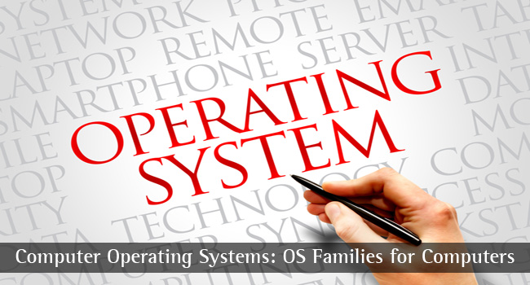
CS-3103 : Operating Systems : Sec-A (NB) :
I/O Management…..
Operating System Concepts

Slide 2
Module 12: I/O Systems
I/O hardwared
Application I/O Interface
Kernel I/O Subsystem
Transforming I/O Requests to Hardware Operations
Performance
Operating System Concepts

Slide 3
I/O Hardware
Incredible variety of I/O devices
Common concepts
  Port
  Bus (daisy chain or shared direct access)
  Controller (host adapter)
I/O instructions control devices
Devices have addresses, used by
  Direct I/O instructions
  Memory-mapped I/O
Operating System Concepts

Slide 4
Polling
Determines state of device
  command-ready
  busy
  error
Busy-wait cycle to wait for I/O from device
Operating System Concepts

Slide 5
Interrupts
CPU Interrupt request line triggered by I/O device
Interrupt handler receives interrupts
Maskable to ignore or delay some interrupts
Interrupt vector to dispatch interrupt to correct handler
  Based on priority
  Some unmaskable
Interrupt mechanism also used for exceptions
Operating System Concepts

Slide 6
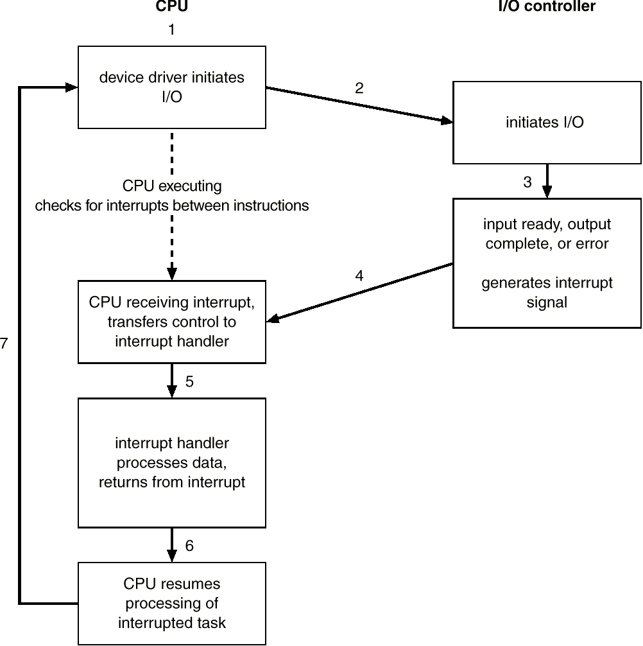
Interrupt-drive I/O Cycle
Operating System Concepts

Slide 7
Direct Memory Access
Used to avoid programmed I/O for large data movement
Requires DMA controller
Bypasses CPU to transfer data directly between I/O device and memory
Operating System Concepts

Slide 8

Six step process to perform DMA transfer
Operating System Concepts

Slide 9
Application I/O Interface
I/O system calls encapsulate device behaviors in generic classes
Device-driver layer hides differences among I/O controllers from kernel
Devices vary in many dimensions
  Character-stream or block
  Sequential or random-access
  Sharable or dedicated
  Speed of operation
  read-write, read only, or write only
Operating System Concepts

Slide 10
Block and Character Devices
Block devices include disk drives
  Commands include read, write, seek
  Raw I/O or file-system access
  Memory-mapped file access possible
Character devices include keyboards, mice, serial ports
  Commands include get, put
  Libraries layered on top allow line editing
Operating System Concepts

Slide 11
Network Devices
Varying enough from block and character to have own interface
Unix and Windows/NT include socket interface
  Separates network protocol from network operation
  Includes select functionality
Approaches vary widely (pipes, FIFOs, streams, queues, mailboxes)
Operating System Concepts

Slide 12
Clocks and Timers
Provide current time, elapsed time, timer
if programmable interval time used for timings, periodic interrupts
ioctl (on UNIX) covers odd aspects of I/O such as clocks and timers
Operating System Concepts

Slide 13
Blocking and Nonblocking I/O
Blocking - process suspended until I/O completed
  Easy to use and understand
  Insufficient for some needs
Nonblocking - I/O call returns as much as available
  User interface, data copy (buffered I/O)
  Implemented via multi-threading
  Returns quickly with count of bytes read or written
Asynchronous - process runs while I/O executes
  Difficult to use
  I/O subsystem signals process when I/O completed
Operating System Concepts

Slide 14
Kernel I/O Subsystem
Scheduling
  Some I/O request ordering via per-device queue
  Some OSs try fairness
Buffering - store data in memory while transferring between devices
  To cope with device speed mismatch
  To cope with device transfer size mismatch
  To maintain “copy semantics”
Operating System Concepts

Slide 15
Kernel I/O Subsystem
Caching - fast memory holding copy of data
  Always just a copy
  Key to performance
Spooling - hold output for a device
  If device can serve only one request at a time
  i.e., Printing
Device reservation - provides exclusive access to a device
  System calls for allocation and deallocation
  Watch out for deadlock
Operating System Concepts

Slide 16
Error Handling
OS can recover from disk read, device unavailable, transient write failures
Most return an error number or code when I/O request fails
System error logs hold problem reports
Operating System Concepts

Slide 17
Kernel Data Structures
Kernel keeps state info for I/O components, including open file tables, network connections, character device state
Many, many complex data structures to track buffers, memory allocation, “dirty” blocks
Some use object-oriented methods and message passing to implement I/O
Operating System Concepts

Slide 18
I/O Requests to Hardware Operations
Consider reading a file from disk for a process
  Determine device holding file
  Translate name to device representation
  Physically read data from disk into buffer
  Make data available to requesting process
  Return control to process
Operating System Concepts

Slide 19
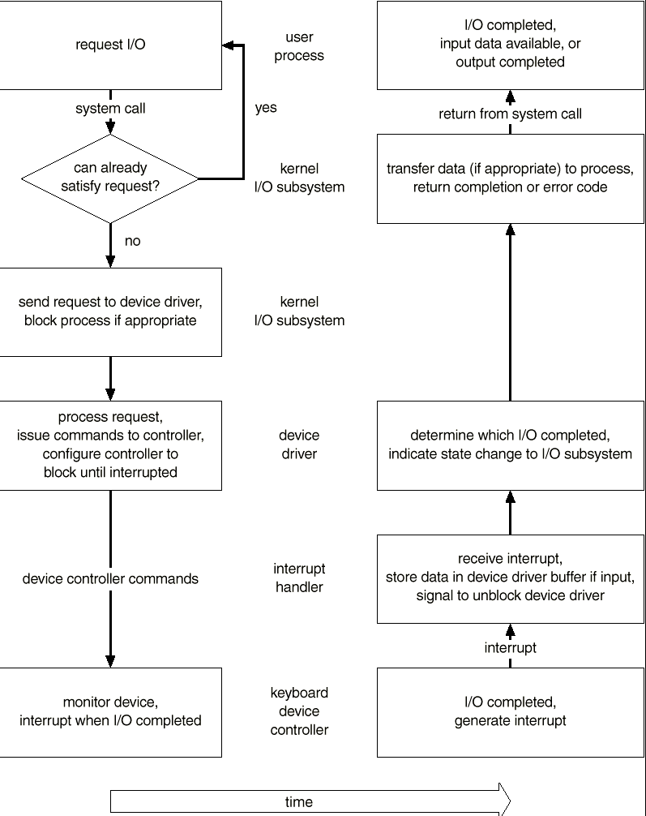
Life Cycle of an I/O Request
Operating System Concepts

Slide 20
Performance
I/O a major factor in system performance
  Demands CPU to execute device driver, kernel I/O code
  Context switches due to interrupts
  Data copying
  Network traffic especially stressful
Operating System Concepts

Slide 21
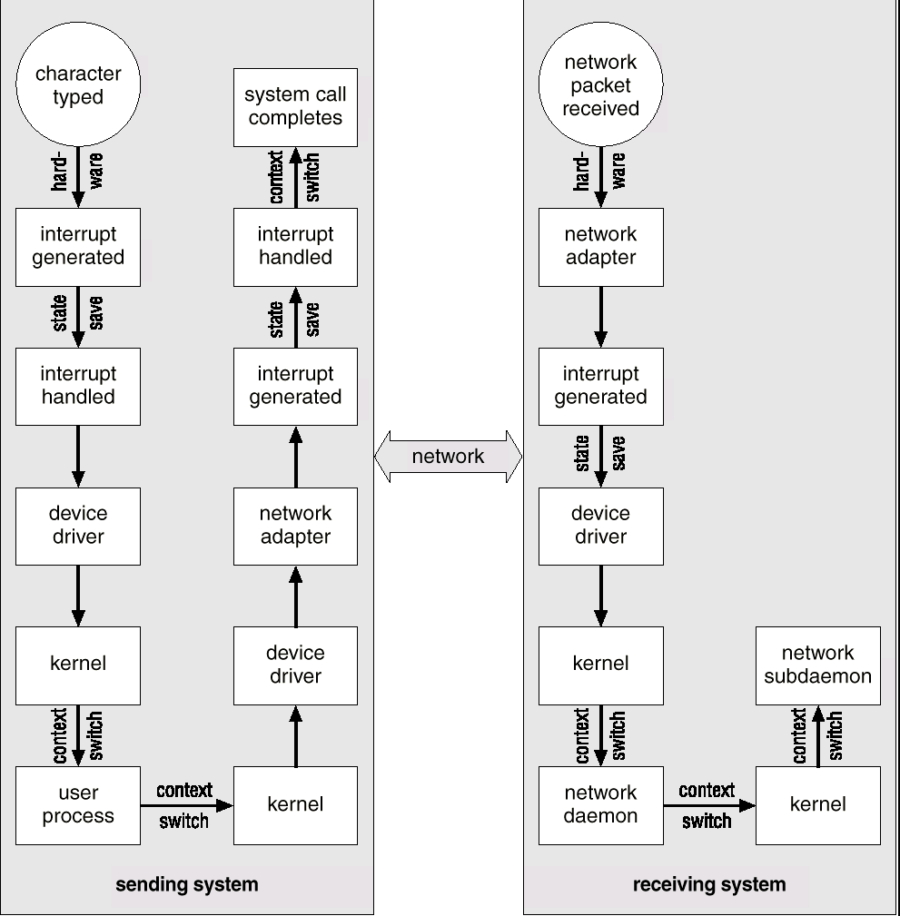
Intercomputer communications
Operating System Concepts

Slide 22
Improving Performance
Reduce number of context switches
Reduce data copying
Reduce interrupts by using large transfers, smart controllers, polling
Use DMA
Balance CPU, memory, bus, and I/O performance for highest throughput
Operating System Concepts

